Slide 1
SQuAD 2.0
Team 12
Sparsh Jain, Mayank Shah
Aalap Patil, Rushabh Karnavat
Done Cohort Presentation

Slide 2
INTRODUCTION
Machine reading comprehension (MRC) in NLP helps machines understand and answer questions based on a given text
Squad 2.0: a challenging NLP task where machines answer questions about passages, including those without answers, pushing the boundaries of current AI
This project contributes to developing powerful QA systems that can effectively process and respond to natural language queries

Slide 3
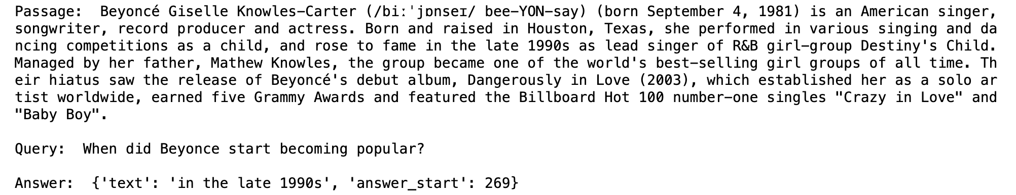
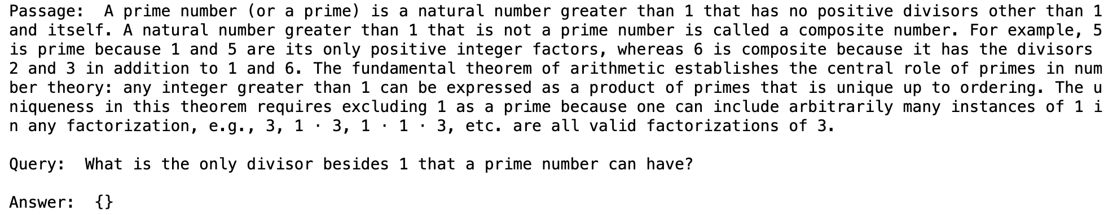
Dataset Details
Datapoint contains three rows: passage, query, and answer.
Train set 130,319 rows containing 19035 passages
Test set 19,135 rows containing 1216 passages

Slide 4

METHODOLOGY
01
03
05
Data Preprocessing
Experiments
Analysis
02
04
Model
Model Evaluation

Slide 5
01
Data Preprocessing
Processing the data to make it trainable for the models.

Slide 6
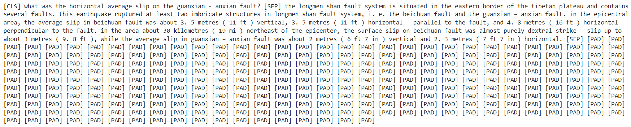
Tokenizing
01
Data Preprocessing
Data was segmented into three lists: questions, answers, and context.
The final character position was determined by considering the context, taking into account the length of the answer and its starting position.
By employing the BERT tokenizer, query and context were tokenized successfully.
Next, the start and end positions were converted to token start and end positions.

Slide 7

Model
02
Training the model on SQuAD 2.0

Slide 8
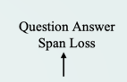
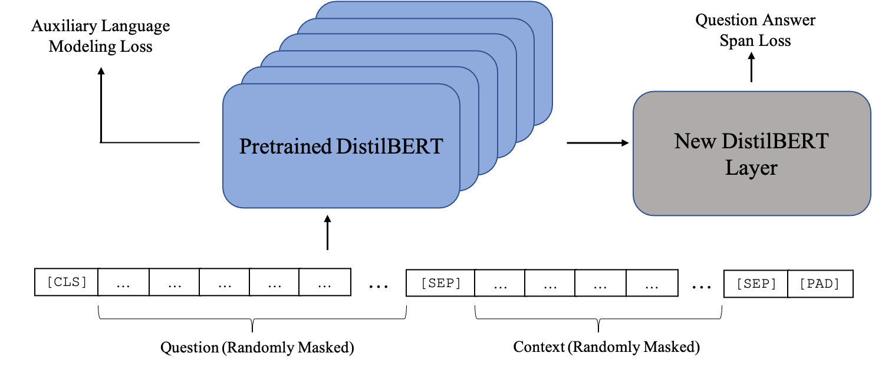
Baseline Model
02
Model
BERT FOR QA
SQuAD 2.0 Test Evaluation

Slide 9

Fine-Tuned BERTforQA Model
02
Model
SQuAD 2.0 Training Data
BERT FOR QA
SQuAD 2.0 Test Evaluation
Fine-Tuning

Slide 10

Experiments
03
Choosing right parameters values for the scratch model

Slide 11
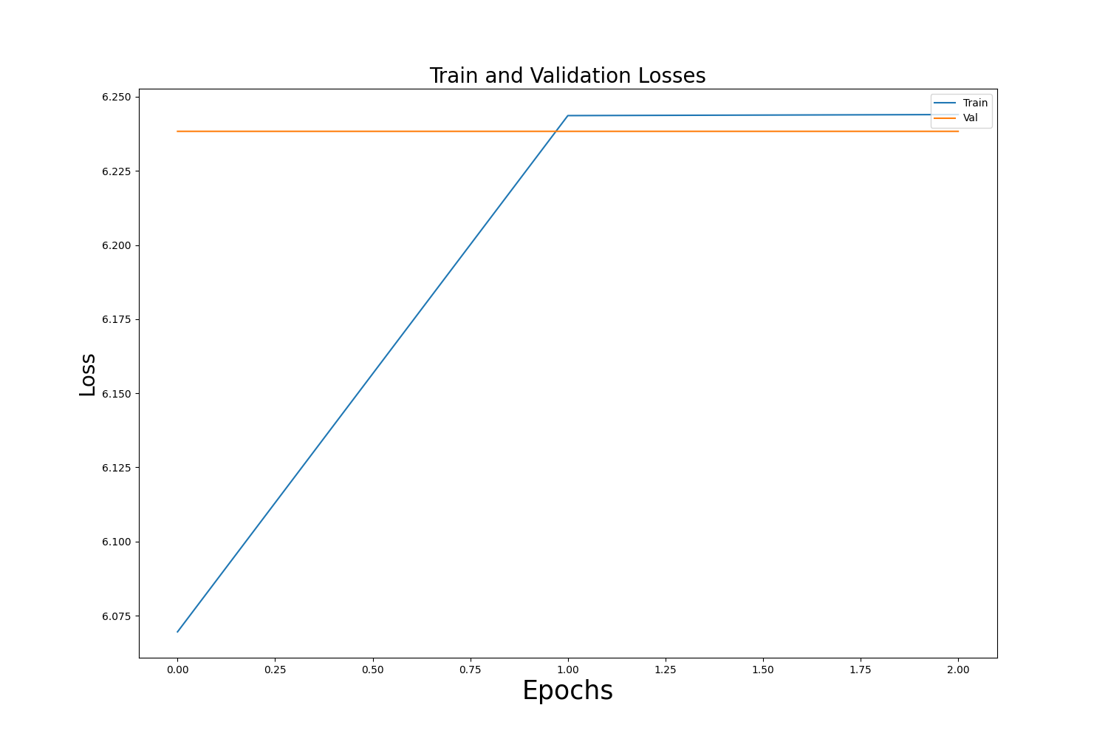
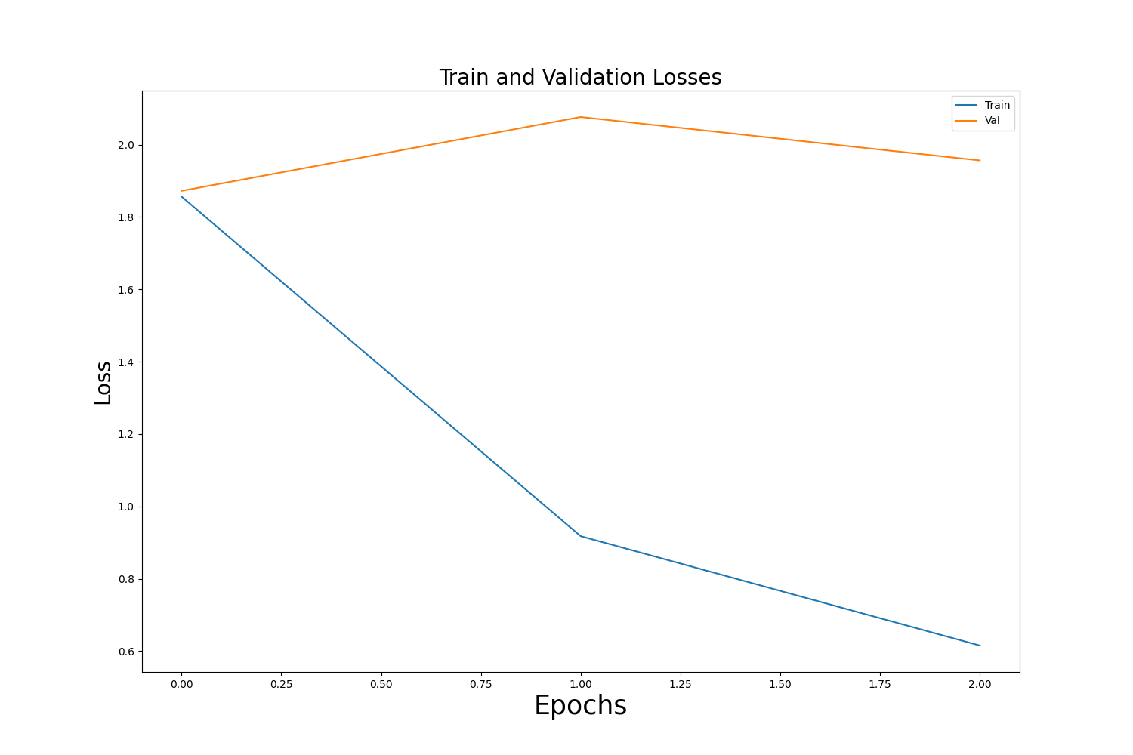
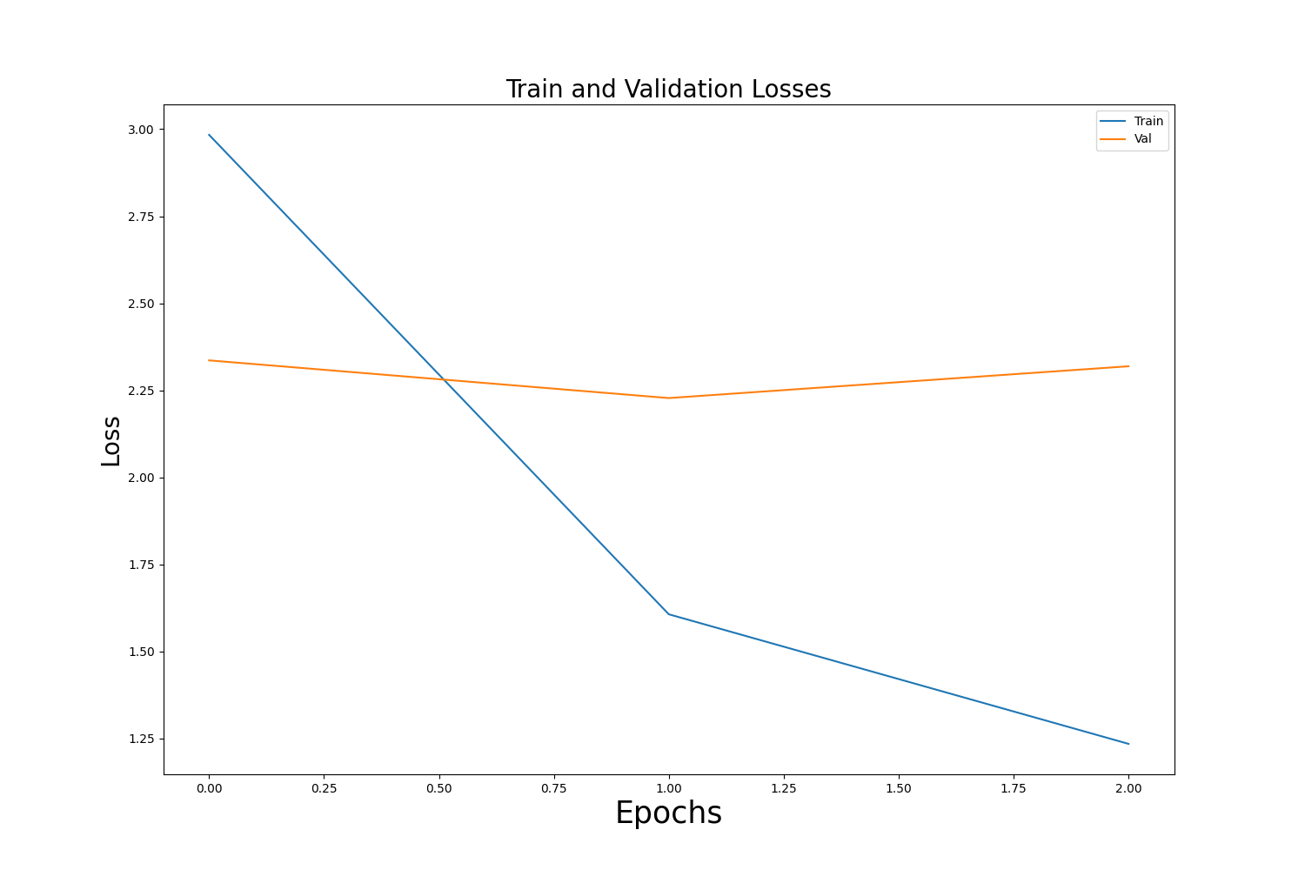
Epochs vs Loss
03
Experiments
LR: 5e-4
LR: 5e-5
TL : 6.241
VL : 6.238
TL : 0.624
VL : 1.908
LR: 5e-6
TL : 1.258
VL : 2.296
LR: Learning Rate
TL: Training Loss
VL: Validation Loss

Slide 12
Model
02
2.0
Training the model on SQuAD 2.0

Slide 13
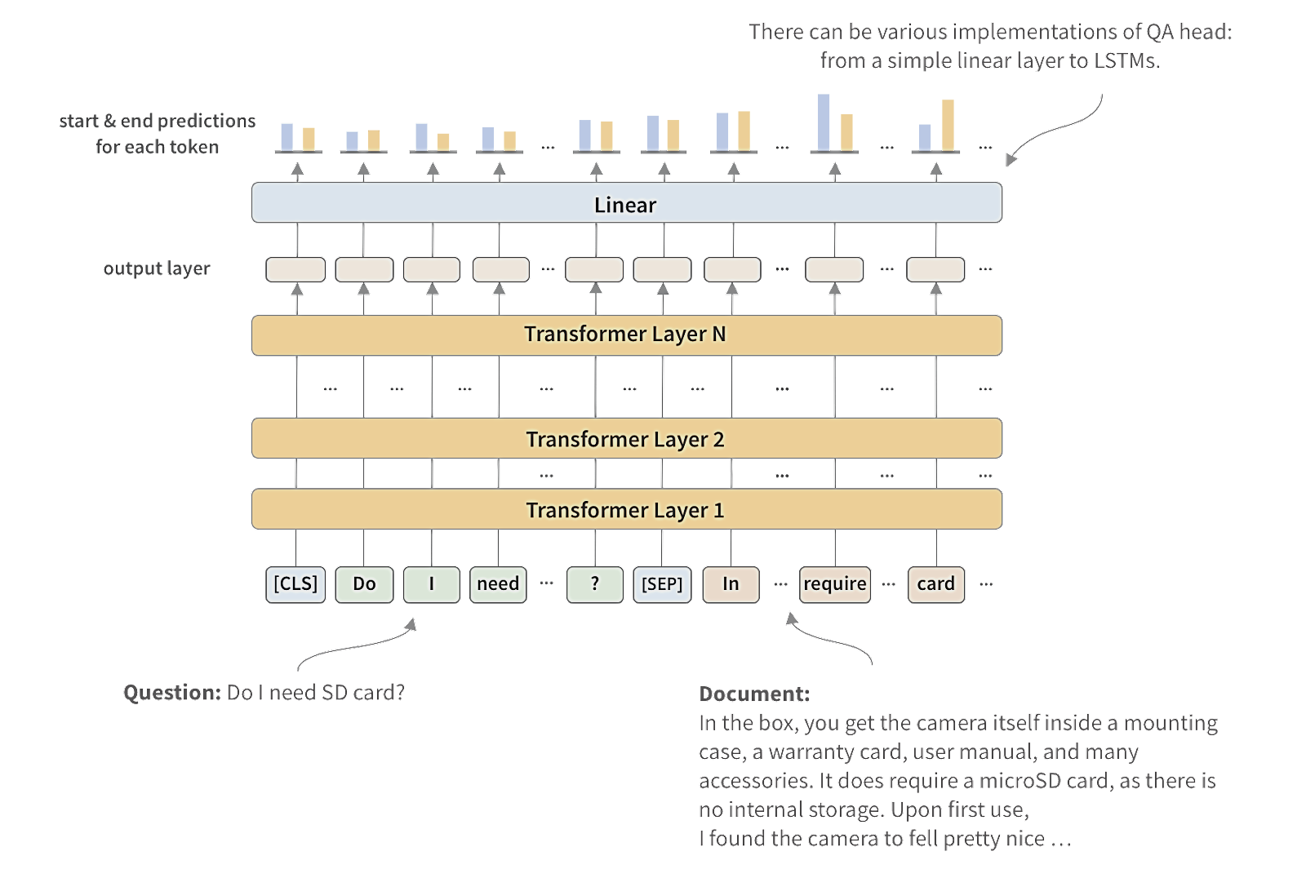
Model from Scratch
02
This QA head contains two layers: a hidden layer of 512 nodes and an output layer containing two nodes
Model
QA Head
Drop out: 0.2
BERT base uncased

Slide 14
Experiments
03
2.0
Choosing right parameters values for the scratch model

Slide 15
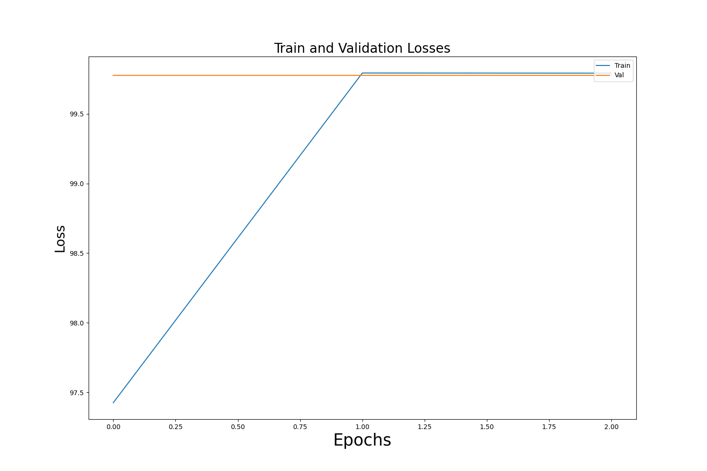
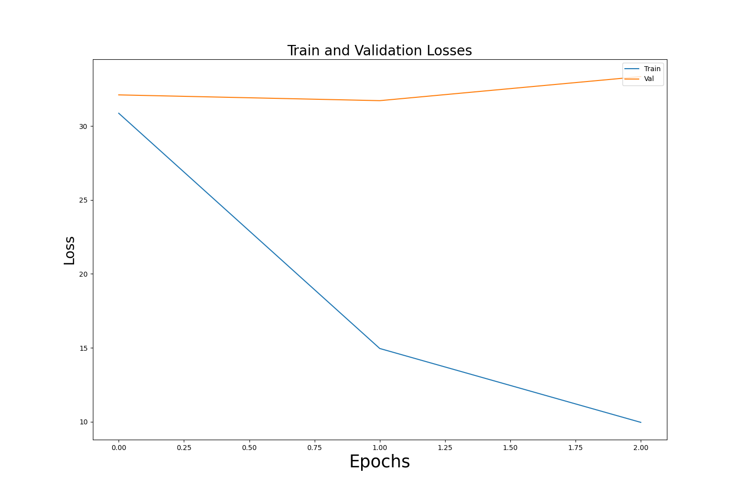
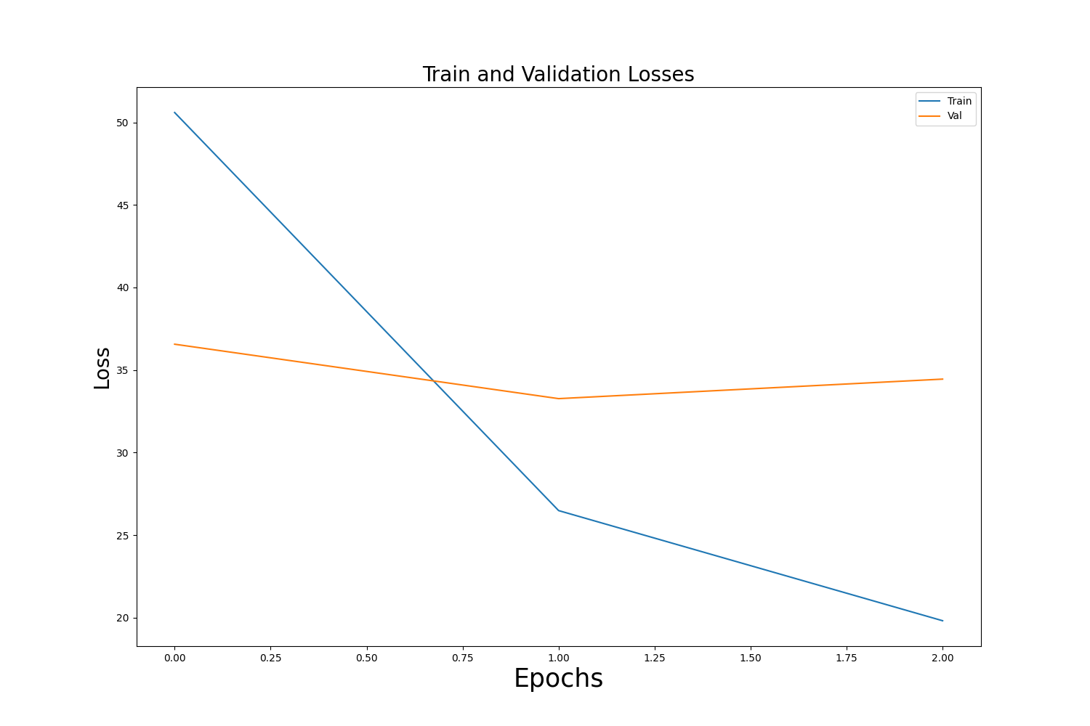
Epochs vs Loss
03
Experiments
LR: 5e-4
LR: 5e-4
LR: 5e-5
TL : 99.861
VL : 99.783
TL : 10.015
VL : 33.976
LR: 5e-6
TL : 19.754
VL : 35.663
LR: Learning Rate
TL: Training Loss
VL: Validation Loss

Slide 16

04
Model Evaluation
Evaluating and comparing all the models

Slide 17
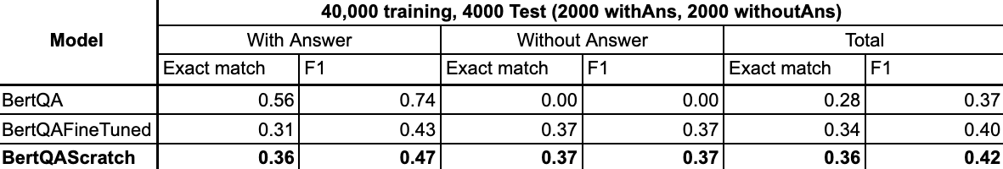
Results
04
Model Evaluation
Epochs:3
Optimizer: Adam
Learning Rate: 5e-5
Training Loss: 9.608
Batch size:8
Training Data: 40k
Validation Data: 5k
Validation Loss: 26.277

Slide 18
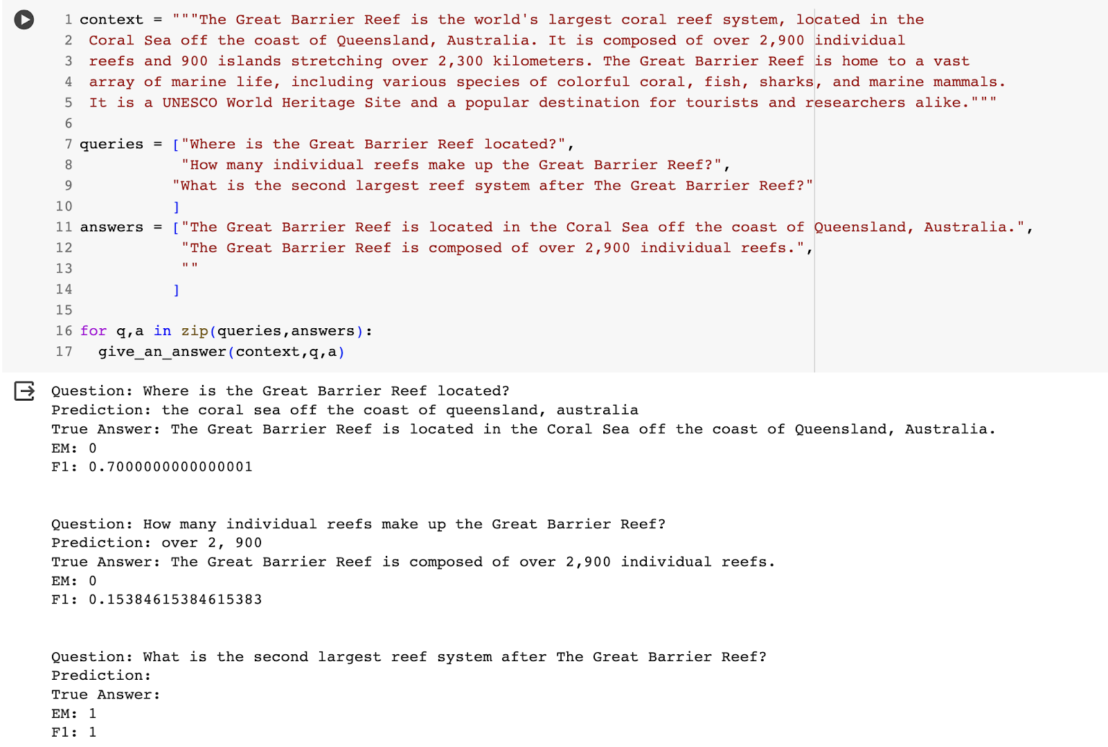
Results
04
Model Evaluation

Slide 19

05
Analysis
Diving deep into the results

Slide 20
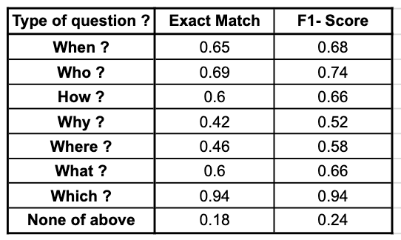
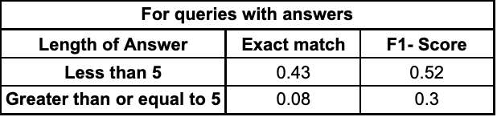
Post Results
05
Analysis
Our model performs better in structured questions. But it gives poor predictions for unstructured questions.
We can also observe that the model performs much better for questions with short answers than longer answers.
The reason for this being the lesser amount of data for long answers.

Slide 21
CONCLUSION
The BERT pretrained model may be used to answer questions, and its performance can be enhanced by fine tuning on a given dataset.
By adding a task-specific head to its last hidden layer, BERT may be downstreamed to any task-specific model.
This model can be enhanced by training it on more data using computational power.

